Slide 1

Multivariate Linear Regression
Ian Jasper A. Agulo, Ph.D.
Department of Physical Sciences
College of Science, University of the Philippines Baguio

Slide 2
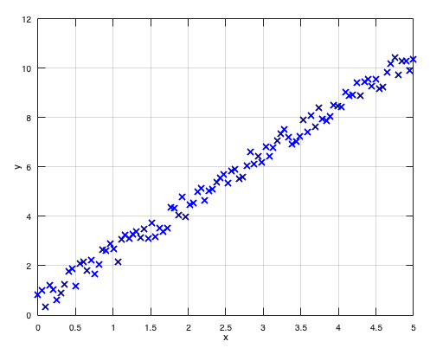
Single Feature Linear Regression
Notes:
When we started out this course, we used a single feature data set, such as the one shown. In this data set, the variable y is dependent only on the variable, x. Mathematically, we say that x is the independent variable and y is the dependent variable and it depends on the variable x. In machine learning, we call the variable x a feature of the variable y, because any changes to x will lead to a change in y.
I’m sure you can think of numerous examples of a single feature data set in physics. For example, the potential energy of an object is linearly dependent on its vertical height. The potential energy is proportionate to the height of your jump. Increase the mass of an object and its weight increases proportionately. For relatively low altitudes relative to sea level, the pressure decrease is also linearly proportional to the altitude.
There are, of course, variables, which sometimes depend on many other variables, we’ll consider such an example next.

Slide 3
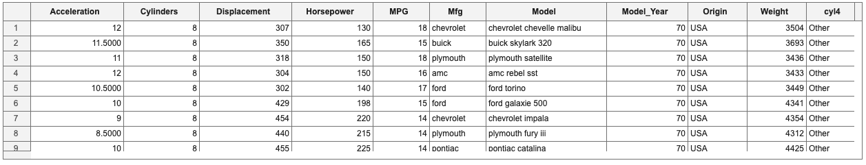
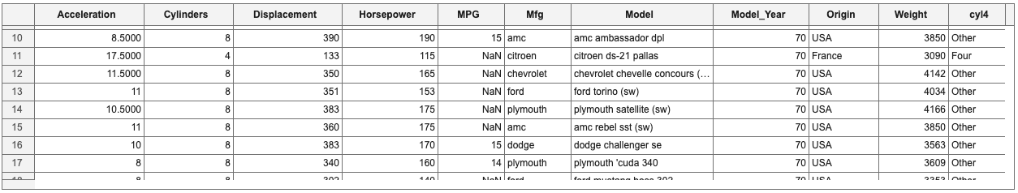
Multi-featured data set
Notes:
This data set is a multi-featured data set. It describes the various features of various cars – its acceleration, the number of cylinders, the displacement of the cylinder, its horsepower, its weight, and its miles per gallon, among other features. To make it simple, we’ll just select these columns with numerical values. Generally, we can use even the columns with text values by assigning a specific number to a specific value, but we won’t do that for now. So, we’ll only be considering the following variables – Acceleration, Cylinders, Displacement, Horsepower, Weight and MPG.
We will also take a look at how the MPG is affected by all the other variables. Thus, in this example, we’ll consider MPG as the dependent variable and the remaining five variables as the independent variables or the features that the MPG is dependent on.
Before anything else, we need to clean the data. If we scroll down, we see that there are some cells with NaN or not a number values. So, we need to remove this. You’ll see how this is done in the accompanying sample program. You’ll also see that we removed the data set with texts.

Slide 4
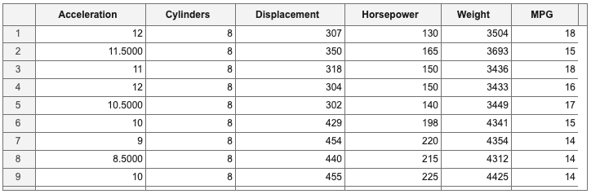
Multi-featured data set
$$x_{1}$$
$$x_{2}$$
$$x_{3}$$
$$x_{4}$$
$$x_{5}$$
$$y$$
$$Single feature: h_{θ}\left(x\right)=θ_{0}+θ_{1}x$$
$$Generalization of single feature: h_{θ}\left(x\right)=θ_{0}x_{0}+θ_{1}x_{1},x_{0}=1$$
Notes:
Here’s the clean and rearranged data set. The rows with element values of NaN have been removed. The first five columns are the features, while the last column is the dependent variable. We call the dependent variable as the hypothesis, the same way we called the y-axis in the single-featured data set the hypothesis. In the same way, we annotate our features as $x_{j}$, where $j$ is the $j^{th}$ feature and ranges from $1$ to $n$, where $n$ is the number of features. In other words, we call the Acceleration as $x_{1}$, the number of Cylinders as $x_{2}$, the Displacement as $x_{3}$, the Horsepower as $x_{4}$ and the Weight as $x_{5}$. There are $n=5$features.
Recall that for our single-featured data set, we have a linear equation relating the hypothesis with the feature. We can generalize this and rewrite the hypothesis as $h_{θ}\left(x\right)=θ_{0}x_{0}+θ_{1}x_{1}$, where $x_{0}=1$. In machine learning, the features, $x_{j}$, are referred to as the input features, while the variable $y$ is called the output feature.

Slide 5
Multi-featured data set
$$x_{1}$$
$$x_{2}$$
$$x_{3}$$
$$x_{4}$$
$$x_{5}$$
$$y$$
$$x_{1}^{(4)}$$
$$x_{4}^{(9)}$$
$$Generalization of multi−feature:$$
$$h_{θ}\left(x\right)=θ_{0}x_{0}+θ_{1}x_{1}+θ_{2}x_{2}+θ_{3}x_{3}+θ_{4}x_{4}+θ_{5}x_{5}, x_{0}=1$$
Notes:
For a multi-featured data set, we write $h_{θ}\left(x\right)=θ_{0}x_{0}+θ_{1}x_{1}+θ_{2}x_{2}+θ_{3}x_{3}+θ_{4}x_{4}+θ_{5}x_{5}$, where $x_{0}=1$. Here, the Acceleration is labelled as $x_{1}$, the number of Cylinders as $x_{2}$, the Displacement as $x_{3}$, the Horsepower as $x_{4}$ and the Weight as $x_{5}$. Again, $x_{i}$ are the input features. The MPG, denoted with $y$, is called the output feature.
To call on the row element, we use a superscript. In other words, the 4th element of the Acceleration is denoted as $x_{1}^{(4)}$. The 9th element of the Horsepower is denoted as $x_{4}^{(9)}$We enclose the row number with a parenthesis, so that it doesn’t get confused with the power of a number.
We denote the row number with the variable, $i$, and the number of rows with the variable $m$, so that i$=1 to m$. This data set has 392 rows and 6 columns, so $m=392$ and $n=6$. Thus, we can represent this data set as a $392×6$ matrix.
The idea here is to make a prediction of the best-fit line that minimizes the difference between the output feature, $y$, and the hypothesis, $h_{θ}\left(x\right)$. Thus, the idea is to solve for the coefficients, $θ_{j}$, of the features, $x_{j}$. Recall that in the single-featured example, we solved for the coefficients $θ_{0}$ and $θ_{1}$. We called $θ_{0}$ the y-intercept, since, by definition, when all the coefficients of the features are zero, then $y=θ_{0}$, considering that $x_{0}=1$. In the multi-featured case, $θ_{0}$, is still called the y-intercept, since the definition has not changed.
It’s quite impossible to graph the multi-featured case. After all, we only live in a 3D world. How can we even begin to imagine a 6D plot? Nevertheless, we trust in the process. We use the same process in the single-featured data set for the multi-featured data set.

Slide 6
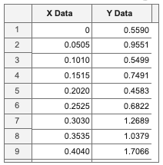
Gradient Descent for Multi-featured Data
$$h_{θ}\left(x\right)=θ_{0}x_{0}+θ_{1}x_{1}+θ_{2}x_{2}+θ_{3}x_{3}+…+θ_{n}x_{n}$$
$$J\left(θ_{0},θ_{1},…,θ_{n}\right)=\frac{1}{2m}\sum_{i=1}^{m}{{\left[h_{θ}\left(x^{(i)}\right)−y^{(i)}\right]}^{2}}$$
X Data | Y Data | Error
$$x_{1}$$ | $$y_{1}$$ | $$e_{1}$$
$$x_{2}$$ | $$y_{2}$$ | $$e_{2}$$
$$x_{3}$$ | $$y_{3}$$ | $$e_{3}$$
$$⋮$$ | $$⋮$$ | $$⋮$$
$$x_{n−2}$$ | $$y_{n−2}$$ | $$e_{n−2}$$
$$x_{n−1}$$ | $$y_{n−1}$$ | $$e_{n−1}$$
$$x_{n}$$ | $$y_{n}$$ | $$e_{n}$$
$$J\left(θ_{0},θ_{1}\right)=\frac{1}{2n}\sum_{i=1}^{n}{{\left[h_{θ}\left(x_{i}\right)−y_{i}\right]}^{2}}$$
Notes:
We begin with the hypothesis. This is a generalized version. The subscript is denoted by the variable $j=0 to n$ and $n$ is the number of input features. We write the cost function as
$$J\left(θ_{0},θ_{1},…,θ_{n}\right)=\frac{1}{2m}\sum_{i=1}^{m}{{\left[h_{θ}\left(x^{(i)}\right)−y^{(i)}\right]}^{2}}$$
When you review your notes for the single-featured cost function, you’ll probably see this equation
$$J\left(θ_{0},θ_{1}\right)=\frac{1}{2n}\sum_{i=1}^{n}{{\left[h_{θ}\left(x_{i}\right)−y_{i}\right]}^{2}}$$
They don’t look alike, but they represent exactly the same thing. Recall that in the single-featured data set, you take the difference of the hypothesis, $h_{θ}\left(x\right)$, and the output feature, $y$, per row, $i$, square each of them, and then add them all up before dividing everything by $2m$.

Slide 7
Gradient Descent for Multi-featured Data
$$h_{θ}\left(x\right)=θ_{0}x_{0}+θ_{1}x_{1}+θ_{2}x_{2}+θ_{3}x_{3}+…+θ_{n}x_{n}$$
$$J\left(θ_{0},θ_{1},…,θ_{n}\right)=\frac{1}{2m}\sum_{i=1}^{m}{{\left[h_{θ}\left(x^{(i)}\right)−y^{(i)}\right]}^{2}}$$
$$x_{1}$$
$$x_{2}$$
$$x_{3}$$
$$x_{4}$$
$$x_{5}$$
$$y$$
Notes:
Here, we are doing exactly the same thing. You take the difference of the hypothesis, $h_{θ}\left(x\right)$, and the output feature, $y$, per row, $i$, square each of them, and then add them all up before dividing everything by $2m$, not $2n$, because we recently denoted the number of rows as $m$. We also made a changed in the notation of the row number from a subscript to a superscript enclosed with a parenthesis. Nevertheless, they both represent the same physical quantity, but this one is more generalized to $n$ number of features.

Slide 8
Gradient Descent for Multi-featured Data
$$\frac{∂J\left(θ_{0},θ_{1}\right)}{∂θ_{0}}=\frac{1}{n}\sum_{i=1}^{n}{\left[\left(θ_{0}+θ_{1}x_{i}\right)−y_{i}\right]}$$
Derivatives of the Cost Function:
$$\frac{∂J\left(θ_{0},θ_{1}\right)}{∂θ_{1}}=\frac{1}{n}\sum_{i=1}^{n}{\left[\left(θ_{0}+θ_{1}x_{i}\right)−y_{i}\right]x_{i}}$$
$$\frac{∂J\left(θ_{0},θ_{1}\right)}{∂θ_{0}}=\frac{1}{m}\sum_{i=1}^{m}{\left[\left(θ_{0}+θ_{1}x^{(i)}\right)−y^{(i)}\right]}$$
Derivatives of the Cost Function:
$$\frac{∂J\left(θ_{0},θ_{1}\right)}{∂θ_{1}}=\frac{1}{m}\sum_{i=1}^{m}{\left[\left(θ_{0}+θ_{1}x^{(i)}\right)−y^{(i)}\right]x^{(i)}}$$
Notes:
Recall that for the single-featured data set, we derived the derivatives of the cost function as these two expressions.
$$\frac{∂J\left(θ_{0},θ_{1}\right)}{∂θ_{0}}=\frac{1}{m}\sum_{j=1}^{m}{\left[\left(θ_{0}+θ_{1}x_{i}\right)−y_{i}\right]} and \frac{∂J\left(θ_{0},θ_{1}\right)}{∂θ_{1}}=\frac{1}{n}\sum_{i=1}^{n}{\left[\left(θ_{0}+θ_{1}x_{i}\right)−y_{i}\right]x_{i}}$$
In our new notation, this is rewritten as
$$\frac{∂J\left(θ_{0},θ_{1}\right)}{∂θ_{0}}=\frac{1}{m}\sum_{i=1}^{m}{\left[\left(θ_{0}+θ_{1}x^{(i)}\right)−y^{(i)}\right]} and \frac{∂J\left(θ_{0},θ_{1}\right)}{∂θ_{1}}=\frac{1}{m}\sum_{i=1}^{m}{\left[\left(θ_{0}+θ_{1}x^{(i)}\right)−y^{(i)}\right]x^{(i)}}$$

Slide 9
Gradient Descent for Multi-featured Data
$$\frac{∂J\left(θ_{0},θ_{1}\right)}{∂θ_{0}}=\frac{1}{m}\sum_{j=1}^{m}{\left[\left(θ_{0}+θ_{1}x^{(i)}\right)−y^{(i)}\right]}$$
Derivatives of the Cost Function:
$$\frac{∂J\left(θ_{0},θ_{1}\right)}{∂θ_{1}}=\frac{1}{m}\sum_{j=1}^{m}{\left[\left(θ_{0}+θ_{1}x^{(i)}\right)−y^{(i)}\right]x^{(i)}}$$
Generalization:
$$\frac{∂J\left(θ_{0},θ_{1},…,θ_{n}\right)}{∂θ_{i}}=\frac{1}{m}\sum_{i=1}^{m}{\left[\sum_{j=1}^{n}{θ_{j}x_{j}^{(i)}}−y^{(i)}\right]x_{j}^{(i)}},x_{j=0}^{(i)}=1$$
Notes:
We can generalize this, in fact, into one single equation, given by
$$\frac{∂J\left(θ_{0},θ_{1},…,θ_{n}\right)}{∂θ_{i}}=\frac{1}{m}\sum_{i=1}^{m}{\left[\sum_{j=1}^{n}{θ_{j}x_{j}^{(i)}}−y^{(i)}\right]x_{j}^{(i)}}$$
When $j=0$,$x_{j}^{(i)}=1$.

Slide 10
Gradient Descent for Multi-featured Data
$$h_{θ}\left(x\right)=θ_{0}x_{0}+θ_{1}x_{1}+θ_{2}x_{2}+θ_{3}x_{3}+…+θ_{n}x_{n}$$
$$J\left(θ_{0},θ_{1},…,θ_{n}\right)=\frac{1}{2m}\sum_{i=1}^{m}{{\left[h_{θ}\left(x^{(i)}\right)−y^{(i)}\right]}^{2}}$$
$$\frac{∂J\left(θ_{0},θ_{1},…,θ_{n}\right)}{∂θ_{i}}=\frac{1}{m}\sum_{i=1}^{m}{\left[\sum_{j=1}^{n}{θ_{j}x_{j}^{(i)}}−y^{(i)}\right]x_{j}^{(i)}},x_{j=0}^{(i)}=1$$
$$iterate \{θ_{j}=θ_{j}−α\frac{∂J\left(θ_{0},θ_{1},…,θ_{n}\right)}{∂θ_{j}}, j=0,1,2,…,n\}$$
Notes:
We need only one more step to implement gradient descent and that is to iteratively change the feature values by subtracting the computed gradient descent during each iteration.
In this slide, you have everything you need to implement machine learning.

Slide 11
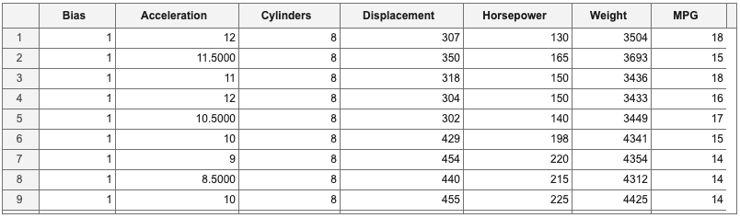
Implementation of Gradient Descent
$$h_{θ}\left(x\right)=θ_{0}x_{0}+θ_{1}x_{1}+θ_{2}x_{2}+θ_{3}x_{3}+…+θ_{n}x_{n}$$
$$x_{0}$$
$$x_{1}$$
$$x_{2}$$
$$x_{3}$$
$$x_{4}$$
$$x_{5}$$
$$y$$
Notes:
Now, it’s time to implement this in code.
Let’s begin with the hypothesis. First, let’s add a column to include $x_{0}$. The column matrix all have values of $1$, as shown. We now have six input features, including the bias, and one output feature.

Slide 12
Implementation of Gradient Descent
$$h_{θ}\left(x\right)=θ_{0}x_{0}+θ_{1}x_{1}+θ_{2}x_{2}+θ_{3}x_{3}+…+θ_{n}x_{n}$$
$$θ=\left[\begin{matrix}θ_{0} \\ θ_{1} \\ \begin{matrix}⋮ \\ θ_{n}\end{matrix}\end{matrix}\right]$$
$$x=\left[\begin{matrix}x_{0} \\ x_{1} \\ \begin{matrix}⋮ \\ x_{n}\end{matrix}\end{matrix}\right]$$
$h_{θ}\left(x\right)=θ^{T}x=\left[\begin{matrix}\begin{matrix}θ_{0} & θ_{1}\end{matrix} & \begin{matrix}⋯ & θ_{n}\end{matrix}\end{matrix}\right]$ $\left[\begin{matrix}\begin{matrix}x_{0} \\ x_{1}\end{matrix} \\ \begin{matrix}⋮ \\ x_{n}\end{matrix}\end{matrix}\right]$
Notes:
We’re going to rewrite the hypothesis, $h_{θ}\left(x\right)$, in matrix notation. We write both the coefficients and features as column matrices, $θ$ and $x$, respectively.
$$θ=\left[\begin{matrix}θ_{0} \\ θ_{1} \\ \begin{matrix}⋮ \\ θ_{n}\end{matrix}\end{matrix}\right] and x=\left[\begin{matrix}x_{0} \\ x_{1} \\ \begin{matrix}⋮ \\ x_{n}\end{matrix}\end{matrix}\right]$$
Then, we take the transpose of matrix, $θ$, and multiply it by the matrix, $x$. So, that our new hypothesis is in the form of a matrix, given by
$h_{θ}\left(x\right)=θ^{T}x=\left[\begin{matrix}\begin{matrix}θ_{0} & θ_{1}\end{matrix} & \begin{matrix}⋯ & θ_{n}\end{matrix}\end{matrix}\right]$ $\left[\begin{matrix}\begin{matrix}x_{0} \\ x_{1}\end{matrix} \\ \begin{matrix}⋮ \\ x_{n}\end{matrix}\end{matrix}\right]$
This is the mathematical operation for each row.

Slide 13
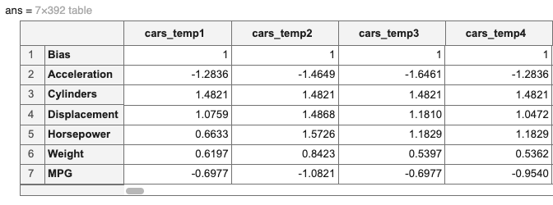
$h_{θ}\left(x\right)=θ^{T}x=\left[\begin{matrix}\begin{matrix}θ_{0} & θ_{1}\end{matrix} & \begin{matrix}⋯ & θ_{n}\end{matrix}\end{matrix}\right]$ $\left[\begin{matrix}\begin{matrix}x_{0} \\ x_{1}\end{matrix} \\ \begin{matrix}⋮ \\ x_{n}\end{matrix}\end{matrix}\right]$
$$\left[\begin{matrix}\begin{matrix}θ_{0} & θ_{1}\end{matrix} & \begin{matrix}\begin{matrix}\begin{matrix}θ_{2} & θ_{3}\end{matrix} & \begin{matrix}θ_{4} & θ_{5}\end{matrix}\end{matrix} & \end{matrix}\end{matrix}\right]$$
Notes:
This is the mathematical operation for each row. We note that data set has been transposed. The output of multiplying the row matrix $θ$ with $1×6$ dimensions with the whole data set for $x$ with $6×392$ dimension is a hypothesis that is a row matrix with $1×392$ dimension.
The matrix $y$, which is the 7th row in the transposed data set, is also a

Slide 14
$h_{θ}\left(x\right)=θ^{T}x=\left[\begin{matrix}\begin{matrix}θ_{0} & θ_{1}\end{matrix} & \begin{matrix}⋯ & θ_{n}\end{matrix}\end{matrix}\right]$ $\left[\begin{matrix}\begin{matrix}x_{0} \\ x_{1}\end{matrix} \\ \begin{matrix}⋮ \\ x_{n}\end{matrix}\end{matrix}\right]$
$h_{θ}\left(x\right)−y=θ^{T}x−y=\left[\begin{matrix}\begin{matrix}θ_{0} & θ_{1}\end{matrix} & \begin{matrix}⋯ & θ_{n}\end{matrix}\end{matrix}\right]$ $\left[\begin{matrix}\begin{matrix}x_{0} \\ x_{1}\end{matrix} \\ \begin{matrix}⋮ \\ x_{n}\end{matrix}\end{matrix}\right]−\left[\begin{matrix}y_{0} \\ y_{0} \\ \begin{matrix}⋮ \\ y_{n}\end{matrix}\end{matrix}\right]$
Notes:
To get the cost-function, we first subtract the output feature, $y$, from the hypothesis, where the column, $y$, is a column matrix, given by
$$y=\left[\begin{matrix}y_{0} \\ y_{0} \\ \begin{matrix}⋮ \\ y_{n}\end{matrix}\end{matrix}\right]$$
Thus, the difference is now written as
$h_{θ}\left(x\right)−y=θ^{T}x−y=\left[\begin{matrix}\begin{matrix}θ_{0} & θ_{1}\end{matrix} & \begin{matrix}⋯ & θ_{n}\end{matrix}\end{matrix}\right]$ $\left[\begin{matrix}\begin{matrix}x_{0} \\ x_{1}\end{matrix} \\ \begin{matrix}⋮ \\ x_{n}\end{matrix}\end{matrix}\right]−\left[\begin{matrix}y_{0} \\ y_{0} \\ \begin{matrix}⋮ \\ y_{n}\end{matrix}\end{matrix}\right]$
Then, we square this difference and sum the squares before dividing this by twice the number of rows to get the cost function.

Slide 15
$$J\left(θ_{0},θ_{1},…,θ_{n}\right)=\frac{1}{2m}\sum_{i=1}^{m}{{\left[h_{θ}\left(x^{(i)}\right)−y^{(i)}\right]}^{2}}$$
$$\left[\begin{matrix}\begin{matrix}θ_{0} & θ_{1}\end{matrix} & \begin{matrix}\begin{matrix}\begin{matrix}θ_{2} & θ_{3}\end{matrix} & \begin{matrix}θ_{4} & θ_{5}\end{matrix}\end{matrix} & θ_{6}\end{matrix}\end{matrix}\right]$$
Notes:
Thus, when solving for the cost function, the hypothesis, $h_{θ}\left(x^{(j)}\right)$, is a row matrix with $1×m$ dimension, where $m=392$, the number of rows of the data set.
The matrix $y$, which is the 7th row in the transposed data set, is also a row matrix with $1×m$ dimension.
Thus, the difference $h_{θ}\left(x^{(i)}\right)−y^{(i)}$ is also a row matrix with $1×m$ dimension. When we sum over all rows and divide by $2m$, we get a single value for the cost function.

Slide 16



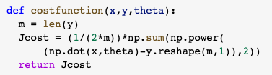
$$J\left(θ_{0},θ_{1},…,θ_{n}\right)=\frac{1}{2m}\sum_{i=1}^{m}{{\left[h_{θ}\left(x^{(i)}\right)−y^{(i)}\right]}^{2}}$$
$$h_{θ}\left(x\right)=θ^{T}x$$
Notes:
Here’s how we implement this in code.
First, let’s take a look at the hypothesis. Recall that the hypothesis is written as
$$h_{θ}\left(x\right)=θ^{T}x$$
Recall as well that the input feature variable $x$ is a $392×6$ matrix and needs to be transposed so that it is correctly multiplied with $θ^{T}$ which is a $1×6$ matrix. The product gives us a $1×392$ matrix. Since the output feature variable $y$ is a $392×1$ matrix, it needs to be transposed as well to be able to perform proper matrix subtraction. The difference still gives us a $1×392$ matrix. Rewriting $theta^{′}∗x′$ as $\left(x∗theta\right)′$ will make it easier for us to transpose the whole expression. This becomes then a $392×1$ matrix.
Then, we take the square of the transpose of the difference between $x∗theta$ and $y$ and the sum all terms. This is the same as with not doing the transpose of the difference, since we’re just taking the sum of all terms.
Thus, we have the final expression in code for the cost function written as a MATLAB function $costfunction$ with input arguments $x$, $y$, and $theta$. For Python, it’s practically the same. The only difference is that the output feature variable $y$ is reshaped from $\left(m,\right)$ to $\left(m,1\right)$, so that it becomes compatible with the shape of $x∗theta$.

Slide 17
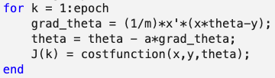

Implementation of Gradient Descent
$$\frac{∂J\left(θ_{0},θ_{1},…,θ_{n}\right)}{∂θ_{i}}=\frac{1}{m}\sum_{i=1}^{m}{\left[\sum_{j=1}^{n}{θ_{j}x_{j}^{(i)}}−y^{(i)}\right]x_{j}^{(i)}},x_{j=0}^{(i)}=1$$
$$iterate \{θ_{j}=θ_{j}−α\frac{∂J\left(θ_{0},θ_{1},…,θ_{n}\right)}{∂θ_{j}}, j=0,1,2,…,n\}$$
Notes:
Next, we rewrite the gradient in code. We know that the term in the brackets $392×1$ matrix. Each of these terms is multiplied by the term $x_{j}^{(i)}$, which represents the $j^{th}$ row of the $i^{th}$ column of the input feature $x$. Thus, we are performing a matrix multiplication of a $392×1$ matrix by a $392×1$ matrix. The easiest is to transpose $x^{(i)}$and multiply this by the term in brackets.
Thus, this is a dot product of the transpose of $x^{(i)}$ and the term in brackets. The product gives us a single term, which is the gradient of $J\left(θ_{0},θ_{1},…,θ_{n}\right)$ with respect to $θ_{i}$. We can conveniently perform a dot product of the transpose of $x$, which is a $6×392$, and the term in brackets, which gives us all the elements of the gradient for all $θ_{i}$. The output is a $6×1$ matrix corresponding the gradient of $J$ with respect to all $θ$.
This is then subtracted from the previous value of $θ$ to get new values of $θ$. The process is repeated for the given number of epochs.
The cost function is also computed in each iteration and plotted to get a sense of whether the gradient descent method performed well.
Let’s take a look at how this is implemented in MATLAB and Python.

Slide 18
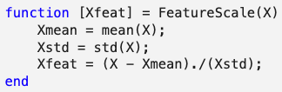
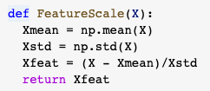
Feature Scaling
By rescaling the input features to an approximate range (or in the order) of $−1≤x≤1$, then cost function
converges faster towards the optimum value.
$$X=\frac{X−\overline{X}}{∆X}$$
Notes:
Feature scaling is a way to improve the efficiency of gradient descent and allowing it to converge faster towards the minimum value. This is a quite simple method. The scaled values are obtained by subtracting the mean value of the input features to the input features and then dividing the result by the standard deviation of the input features.

Slide 19
Summary
Supervised vs unsupervised machine learning
Univariate and Multivariate Linear Regression
Gradient Descent
Machine Learning Features, Theta
Machine Learning Parameters
Machine Learning Terms
Epoch
Hyperparameters
Learning Rate
Techniques to Improve Accuracy
Feature Scaling

